Slide 1
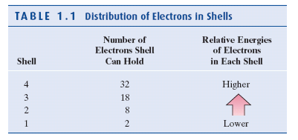
Electrons do not move freely around a nucleus, but rather are confined to
regions of space called principal energy levels (shells).
Shells are numbered as 1, 2, 3 from the inside out.
Each shell can contain up to 2n² electrons (n= number of shell)

Slide 2
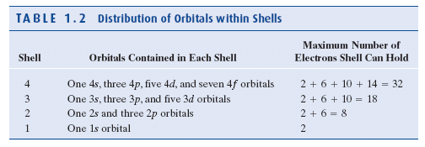
Shells are divided into subshells designated by the letters s, p, d and f
Within these subshells, electrons are grouped in orbitals
Orbital represents the space where an electron spends most (90-95%)
of its time
The 1st shell (n = 1) has only an s orbital (1s)
The 2nd shell (n = 2) has s and p orbitals (2s and 2p)
The 3rd shell (n = 3) has s, p, and d orbitals (3s, 3p, and 3d)

Slide 3

Quantum numbers
There are 4 identification numbers called quantum numbers which
can fully describe an electron in an atom.
Principal quantum number, n:
This quantum number denotes the principal shell to which the electrons
belongs.
Slide <number> of 25
General Chemistry: Chapter 2
Prentice-Hall © 2002

Slide 4

2. Azimuthal quantum number, Ɩ (also called Angular momentum
quantum number):
The quantum number Ɩ defines the shape of the orbital occupied
by the electron and the angular momentum of the electron.
For any given value of n, the Ɩ may have integer values from
0 to n-1, each of which refers to an Energy sublevel or Sub-shell.
These sublevels are symbolised by letters s, p, d, f.
Slide <number> of 25
General Chemistry: Chapter 2
Prentice-Hall © 2002

Slide 5
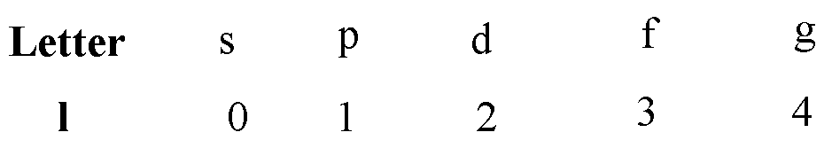
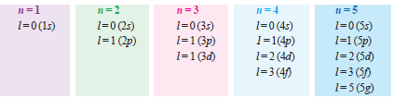
Ɩ = n-1
The different subshells are denoted by letters as follows:
Slide <number> of 25
General Chemistry: Chapter 2
Prentice-Hall © 2002

Slide 6
3. Magnetic quantum number, m_{Ɩ}
Magnetic quantum number (m_{Ɩ}) describes the orientation of the
orbital in space.
Within a subshell, the value of m_{Ɩ} depends on the value of the
angular momentum quantum number, Ɩ
For a certain value of Ɩ , there are (2 Ɩ + 1) integral values of m_{Ɩ}
as follows:
- Ɩ, (- Ɩ +1), ….0,……(+ Ɩ - 1), + Ɩ
Slide <number> of 25
General Chemistry: Chapter 2
Prentice-Hall © 2002

Slide 7
If Ɩ = 0, then m_{Ɩ} = 0
If Ɩ = 1, then there are [(2x1) + 1] = 3 values of m_{Ɩ}.
These are: -1, 0, and 1
If Ɩ = 2, then there are [(2x2) + 1] = 5 values of m_{Ɩ}.
These are: -2, -1, 0, +1 and +2.
4. Spin quantum number, m_{s}
This quantum number refers to the two possible orientations of the
spin axis of an electron; possible values are: +1/2 and –1/2.
Slide <number> of 25
General Chemistry: Chapter 2
Prentice-Hall © 2002

Slide 8
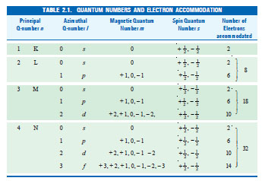
Slide <number> of 25
General Chemistry: Chapter 2
Prentice-Hall © 2002

Slide 9
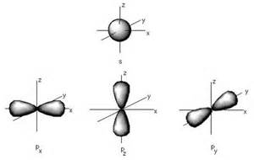
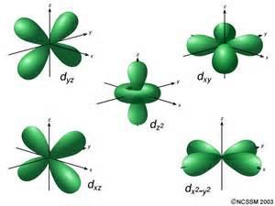
Atomic Orbitals
S Atomic orbital is spherically symmetrical
P Atomic orbitals are not spherically symmetrical. They are dumbbell-shaped
d Atomic orbitals are cloverleaf-shaped

Slide 10
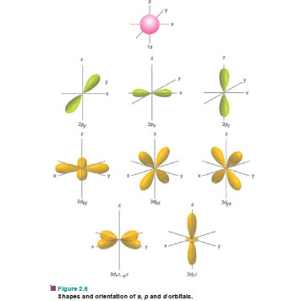
Slide <number> of 25
General Chemistry: Chapter 2
Prentice-Hall © 2002

Slide 11
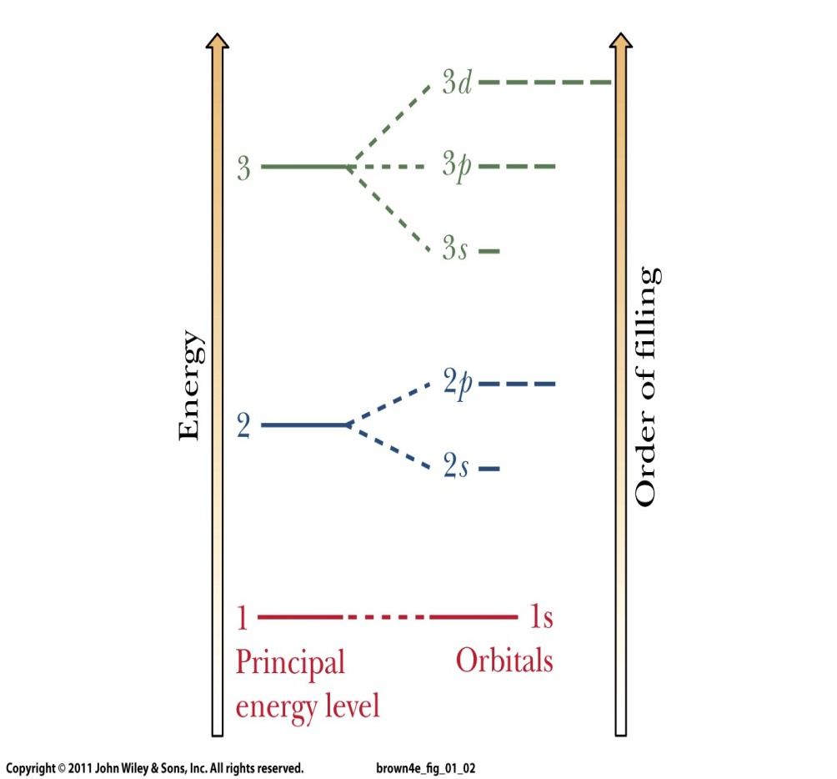
Electron Configuration of Atoms
The electron configuration of an atom is a description of the orbitals the
electrons in the atom occupy.
Ground state electron configuration:
Three rules:
Rule 1: Orbitals fill in order of increasing energy from lowest
to highest.
Rule 2: Each orbital can hold up to two electrons with their
spins paired.

Slide 12
Rule 3: For orbitals with equivalent energy, add one electron to each equivalent orbitals before a second electron is added to any one of them.
Slide <number> of 25
General Chemistry: Chapter 2
Prentice-Hall © 2002

Slide 13
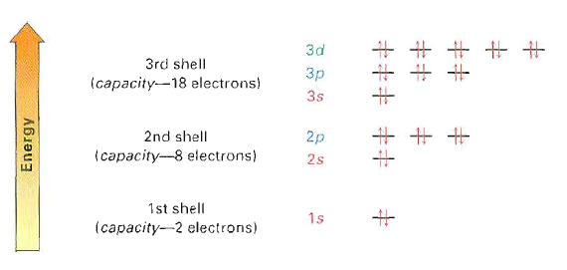
Electron Configuration of Atoms

Slide 14
The increasing order of energy of various orbitals is as follows:
Slide <number> of 25
General Chemistry: Chapter 2
Prentice-Hall © 2002

Slide 15
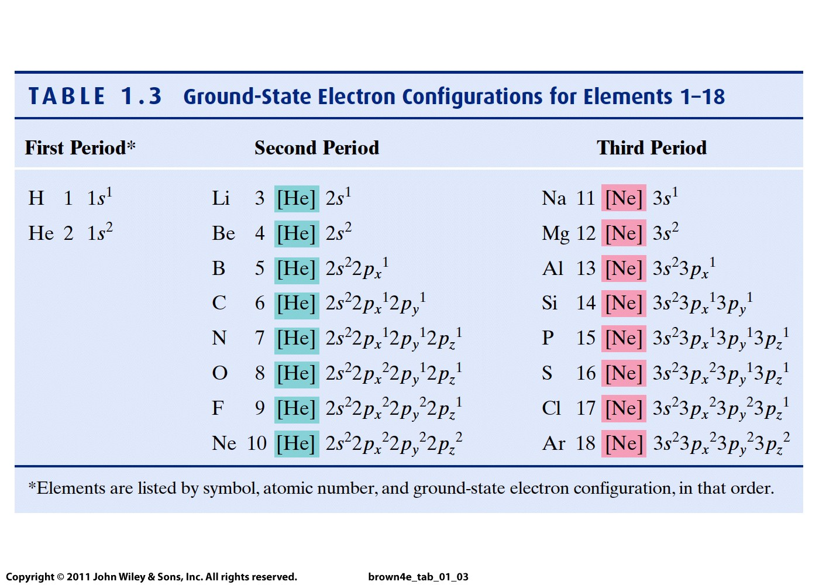
Ground-state Electron Configurations of Some Elements

Slide 16
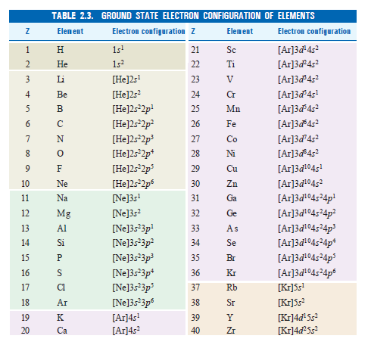
Slide <number> of 25
General Chemistry: Chapter 2
Prentice-Hall © 2002

Slide 17
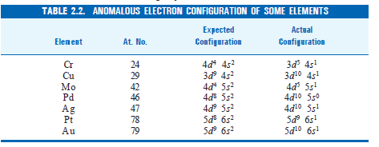
Slide <number> of 25
General Chemistry: Chapter 2
Prentice-Hall © 2002

